Slide 1


تاثیر و نقش تصمیم گیری مبتنی بر شواهد در تصمیمات بالینی و درمان بیماران
Ali Kabir, MD, MPH, MSc,PhD
Associate Professor of Epidemiology,
Resident of Internal Medicine
Firoozgar Hospital, Iran University of Medical Sciences

Slide 2
اعتماد به علم پزشکی رو پیرزن همسایه ما داشت. توی کوچه های محل، اگر قرص یا کپسول پیدا میکرد، میخورد. می گفت حتما برای یه جای بدن خوبه که درستش کردن. اگر بد بود درستش نمیکردن.

Slide 3
اصلاً پزشکی مبتنی بر شواهد چیه؟
ما که نمیرسیم برای هر سؤالی سرچ کنیم؟
سالهاست اساتید پیشکسوت و قدیمی ما همینگونه طبابت میکنند.
این هم یه بازی جدیده چند وقته در اومده و بعدش آخرش هیچ کمکی نمیکنه به ما.
اصلاً اونهایی که این داستانها رو در آورده اند درگیر طبابت تو یه جای شلوغ که باید کلّی مریض ببینی، امکانات تشخیصی هم نداری، داروهای داروخانه ات هم محدود و مریضت هم خودش میگه فلان چرک خشک کن رو بده، ... نبوده اند.
اصلاً این بازیها مال ما نیست. مال کشورهای پیشرفته دنیا است.
...

Slide 4
موضوعات مهم و اثر گذار در حیطه تصمیم گیری های بالینی و بهداشتی مبتنی بر شواهد
Physicians (clinicians, paramedics, consultants, …)
Evidence (availability, national developed/adopted guidelines, …)
Decision aids (Scoring systems, clinical decision support system, …)
Insurance
Clinical knowledge
Patients’ culture/background knowledge
Doctor-patient relationship
Laboratories

Slide 5
Paraclinics
Pharmaceutical company
Cost
Diagnostic/Treatment threshold
Emergency/chronic disease
Simple/Complicated disease
Prevalent/rare disease
Policymakers
Time
Ethical/legal issues

Slide 6
راهکارهای بهبود/ارتقاء پزشکی مبتنی بر شواهد در کشور
Health profile (previous documents, …)
Health camp (gather and clear data, produce graphs and simple most frequent used information, monitor trends and changes, linking these information to guidelines and protocols, use from these information to change actions and policies, … )
Education (Physicians and paramedics, patients, general population, policymakers, …)
Health/clinical data registries (population based, cohorts, clinical data, hospital based data, insurance data, death registries, different data linkage, police data, …: expanding availability of unpublished data)
Linking data from different sources for most important/priorities of the scientific clinical/health issues and producing evidences
Pooling such evidences in important sites like Iran Cochrane
Producing evidence by expert opinion/expert panels in area without sufficient published information by national scientific societies

Slide 7
تاثیر و نقش تصمیم گیری مبتنی بر شواهد در تصمیمات بالینی و درمان بیماران
Evidence-based medicine (EBM) uses the scientific method to organize and apply current data to improve healthcare decisions.
The best available science is combined with the healthcare professional's clinical experience and the patient's values to arrive at the best medical decision for the patient.
To promote better patient care through safe and effective (drug) therapy.

Slide 8
Illness is a biological and social process.
Clinicians who engage in EBM need to acknowledge the social and cultural factors that affect the health-care encounter, understand the important role of those factors in health-care decision making, and expand the paradigm of EBM to incorporate sociocultural influences more explicitly.
Moreover, recognition of the influences family members and other caregivers have within the clinical encounter—by offering opinions and participating in treatment-related decision making—is needed and could lead to more efficient and effective health care.
Siminoff LA. Incorporating patient and family preferences into evidence-based medicine. BMC Med Inform Decis Mak. 2013;13 Suppl 3(Suppl 3):S6

Slide 9
There are two international approaches to treatment decision-making in past three decades: evidence based medicine (EBM) and shared decision-making (SDM).
SDM: use and evaluation of patient decision aids (DA) to help communicate to patients the benefits and risks of various treatment options, thereby creating more informed patients.
  informed patient participation in decisions about their care
  This approach emphasises the cognitive and emotional information processing work that patients undertake in relation to decision-making
Charles C, Gafni A. The vexing problem of defining the meaning, role and measurement of values in treatment decision-making. J Comp Eff Res. 2014 Mar;3(2):197-209.

Slide 10
In the EBM model of practice, there is no clear and consistent definition of patient values/preferences and no guidance is provided on how to integrate these into an EBM model of practice. Methods advocated to measure patient values are also problematic.
Within the SDM movement, patient values/preferences tend to be defined and measured in a restrictive and reductionist way as patient
preferences for treatment options or attributes of options, while broader underlying value structures are ignored.
In both models of practice, the meaning and expected role of physician values in decision-making are unclear.
Charles C, Gafni A. The vexing problem of defining the meaning, role and measurement of values in treatment decision-making. J Comp Eff Res. 2014 Mar;3(2):197-209.

Slide 11
EBM educators should spend more time and emphasis, relative to risk of bias in primary studies, on quality/certainty of bodies of evidence, and much more time and emphasis on understanding of magnitude of effect and applicability of results.(i.e. tripdatabase.com)
Risk of bias assessment is not a core skill for clinicians.
Tikkinen KAO, Guyatt GH. Understanding of research results, evidence summaries and their applicability-not critical appraisal-are core skills of medical curriculum. BMJ Evid Based Med. 2021 Oct;26(5):231-233.

Slide 12
Negative consequences of EBM for healthcare delivery, policy and financing
1. failing to manage complexity, the individual’s needs, and the person’s context and issues such as multi-morbidity;
2. the quantity of research studies and the variable quality, which has become impossible to manage and in some cases lack clinical significance; and
3. the medicalization of life, namely creating new diseases for non-specific complaints and the use of the evidence-based ‘quality markers’ to widely promote drugs and medical devices.
Fernandez, A., et al. Evidence-based medicine: is it a bridge too far?. Health Res Policy Sys 2015;13, 66.

Slide 13
EBM grew too fast to effectively incorporate its original propositions: evidence, expert knowledge, and patients’ preferences.
The reliance of EBM on the RCT was useful for acute (mostly single disease) conditions treated with simple interventions, but this approach is not suitable in the current epidemiological context characterized by chronicity and multimorbidity in complex health systems.
In particular, EBM has largely disregarded the importance of social determinants of health and local context – hence the nicknames ‘cookbook approach’ or ‘MacDonaldization’ of medicine) – and its real impact on the ‘effectiveness’ and ‘efficiency’ of healthcare on the ‘equality’ of needed
healthcare services.
Fernandez, A., et al. Evidence-based medicine: is it a bridge too far?. Health Res Policy Sys 2015;13, 66.

Slide 14
As an a priori, evidence is context sensitive, and therefore to some extent tacit, and both global and local evidence need to be combined in the development of usable recommendations for clinical decision making.
Local evidence includes the presence of modifying factors in the specific settings, magnitude of needs (prevalence, baseline risk or status), patient values, costs (to the patient and the system), and the availability of resources in the system.
Fernandez, A., et al. Evidence-based medicine: is it a bridge too far?. Health Res Policy Sys 2015;13, 66.

Slide 15
This local evidence needs to be combined with ‘expert knowledge’, which should be differentiated from ‘expert opinion’ and valued in a different way.
By ‘expert knowledge’ we mean the implicit knowledge that professionals have that helps them to better understand the local conditions. It is based on data (their accumulated experiences) and thus different to simple opinions or feelings about something.
Fernandez, A., et al. Evidence-based medicine: is it a bridge too far?. Health Res Policy Sys 2015;13, 66.

Slide 16
Expert-Based Collaborative Analysis is a systematic procedure to incorporate expert knowledge into data analysis; such an approach has been proven to be useful when dealing with complex issues and can be seen as a powerful tool in the current health context characterized by an increase in the number of patients with multiple conditions, resulting from heterogeneous genomic/pathophysiological pathways and diverse personal needs.
EBM needs to go beyond the sole use of the RCT and acknowledge that scientific knowledge is multidimensional and cannot be arranged in only one hierarchical system.
Fernandez, A., et al. Evidence-based medicine: is it a bridge too far?. Health Res Policy Sys 2015;13, 66.

Slide 17
Knowledge coming from studies using different methodological approaches is complementary.
To have a complete picture, information coming from explanatory RCTs has to be complemented and contrasted with information coming from pragmatic RCTs evaluating effectiveness in routine practice. This implies some loss of ‘internal validity’ and an increase in the uncertainty of the results, but ‘gains in representativeness’.
Fernandez, A., et al. Evidence-based medicine: is it a bridge too far?. Health Res Policy Sys 2015;13, 66.

Slide 18
The most important challenge facing the EBM movement is the provision of a detailed description of its methods for scientific reasoning. This requires an analysis of its taxonomic principles, including formal definitions of ‘scientific knowledge’, ‘evidence’, and ‘decision making’ in health, as well as the different types of logic inferences used in the scientific reasoning process.
This academic exercise is crucial to clarify the confusion between
‘good’ evidence and scientific ‘truth’.
Fernandez, A., et al. Evidence-based medicine: is it a bridge too far?. Health Res Policy Sys 2015;13, 66.

Slide 19
Health systems research involves different disciplines (including social
ones) with different perspectives, epistemologies, and ways of conceptualizing and conducting research.
Health systems research, as intimated by Cochrane, is broader than identifying ‘clinical effectiveness’ – ‘efficiency’ and ‘equality’ are equally important considerations for achieving successful implementation of health system improvement; therefore, all stakeholders’ fundamental value assumptions should be explicit.
Fernandez, A., et al. Evidence-based medicine: is it a bridge too far?. Health Res Policy Sys 2015;13, 66.

Slide 20
EBM evolved as a social movement that started with agitation (i.e. we need to change the current paradigm based on experience).
It was crystalized by the shared experience of the group at McMaster University and the development of an enduring sense of purpose, disseminated in a series of position papers, declarations, and guidelines published in influential medical journals by key opinion leaders in clinical
epidemiology.
So, ironically, the adoption of EBM by the scientific community was not based on evidence but on authoritative knowledge, precisely the type of approach EBM was meant to replace, a point recently acknowledged by one of its key proponents, Sackett himself.
Fernandez, A., et al. Evidence-based medicine: is it a bridge too far?. Health Res Policy Sys 2015;13, 66.

Slide 21
The methodological quality of consensus-based clinical practice guidelines (CB-CPGs) is obviously lower than evidence-based (EB)-CPGs.
Except for the item, “recommendations were based on evidence of systematic reviews,” there were statistical differences in all other methodological items between the EB-CPGS and CB-CPGS (P < 0.01).
Higher methodological quality has been observed in EB-CPGs.
Zhang R, et al. Analysis of the Status and Trends of Chinese Clinical Practice Guideline Development Between 2010 and 2020: A Systematic Review. Front Med (Lausanne). 2021 Nov 2;8:758617.

Slide 22
which decision-making echelon (‘guideline-based algorithmic’ versus ‘multidisciplinary team’) achieves the optimum balance between quality of care for the patient and physicians’ efforts?
With the help of the proposed applied health informatics innovation, the pressure on care professionals in oncology may be reduced, while quality of care is maintained.
Ebben K, et al. Guideline-Based Algorithmic Recommendations Versus Multidisciplinary Team Advice for Gynecologic Oncology. Stud Health Technol Inform. 2023 May 18;302:605-606.

Slide 23
There is limited evidence in the literature regarding clinical validation and in-use evaluation of commercial multiple sclerosis (MS) quantitative volumetric reporting tools (QReports) with a particular lack of clinician end-user testing.
Mendelsohn Z, et al. Commercial volumetric MRI reporting tools in multiple sclerosis: a systematic review of the evidence. Neuroradiology. 2023 Jan;65(1):5-24.

Slide 24
A special issue of Arthroscopy contains recent influential articles strategically chosen to positively impact patient care.
Quigley R, et al. Orthopaedic Musculoskeletal Biologics Research Impacts Patient Care: The First Annual Arthroscopy Orthobiologics Virtual Special Issue. Arthroscopy. 2023 May;39(5):1117-1118.

Slide 25
There is suboptimal CONSORT adherence for RCTs cited in American Academy of Orthopedic Surgeons (AAOS) Clinical practice guidelines (CPGs) for management of osteoarthritis of the knee.
The CPGs are likely supported by outdated evidence and lack of high-quality reporting.
It is important that evidence used to guide clinical decision making be of the highest quality in order to optimize patient outcomes.
In order for clinicians to confer the greatest benefits to their patients, CPGs should provide the totality of evidence and emphasize emerging high-quality RCTs to ensure up-to-date, evidence-based clinical decision-making.
Waters P, et al. Analysis of the Evidence Underpinning the American Academy of Orthopedic Surgeons Knee Osteoarthritis Clinical Practice Guidelines. Sports Health. 2023 Jan-Feb;15(1):11-25.

Slide 26
Similar to the global situation, the risk of bias (RoB) in Iranian RCTs was found to be mostly high or unclear among 1166 Iranian RCTs included by 571 Cochrane Reviews (CRs).
Kabir A, et al. Risk of Bias in Iranian Randomized Trials Included in Cochrane Reviews. Arch Iran Med. 2022;25(6):375-382.

Slide 27
National Institute for Health and Clinical Excellence (NICE), American College of Chest Physicians (CHEST), and European Association of Urology (EAU) guidelines obtained the highest scores from the Overall Assessment criteria by scoring 6, 5.75, and 5.25 (from total score: 7), respectively.
The domains of "Clarity and presentation" and "Scope and purpose" obtained the highest standardized scores by getting 84.49% and 75.69%, respectively, and "Applicability" with 30.04% obtained the lowest standardized score.
Shakiba B, Kabir A, et al. Evaluation of the quality of clinical guidelines for prophylaxis of venous thromboembolism in urological surgeries by the AGREE II review instrument. Health Sci Rep. 2023 Feb 16;6(2):e1118.

Slide 28
Benefits of clinical decision support systems (CDSS), possible harms, and evidence-based mitigation strategies
A clinical decision support system (CDSS) is intended to improve healthcare delivery by enhancing medical decisions with targeted clinical knowledge, patient information, and other health information.
CDSSs today are primarily used at the point-of-care, for the clinician to combine their knowledge with information or suggestions provided by the CDSS.
CDSS are used to augment clinicians in their complex decision-making processes
Sutton, RT, et al. An overview of clinical decision support systems: benefits, risks, and strategies for success. npj Digit. Med. 2020:3,17.

Slide 29
Functions and advantages of CDSS | Potential harm of CDSS | Solution(s) to mitigate harm
Patient Safety: Reducing incidence of medication/prescribing errors and adverse events | Alert fatigue | Prioritize critical alerts, minimize use of disruptive alerts for non-critical indications
Clinical management: Adherence to clinical guidelines, follow-up and treatment reminders | Negative impact on user skills | Avoid prescriptiveness in system design. Evaluate system impact on an ongoing basis
Cost containment: Reducing test and order duplication, suggesting cheaper medication or treatment options, automating tedious steps to reduce provider workload | Financial challenges | Design and plan for longitudinal cost analysis at the outset. Specify measurements for non-financial benefits where possible
Administrative function/ automation: Diagnostic code selection, automated documentation and note auto-fill | System and content maintenance challenges | (1) Knowledge Management (KM) Service in place, with a focus on translation to CDSS systems. (2) System for measurement and analysis of CDSS performance
Sutton, RT, et al. An overview of clinical decision support systems: benefits, risks, and strategies for success. npj Digit. Med. 2020:3,17.

Slide 30
Functions and advantages of CDSS | Potential harm of CDSS | Solution(s) to mitigate harm
Diagnostics support: Providing diagnostic suggestions based on patient data, automating output from test results. | User distrust of CDSS | Reference expert knowledge— include scientific references in messages where appropriate
Diagnostics Support (Imaging, Laboratory, and Pathology): Augmenting the extraction, visualization, and interpretation of medical images and laboratory test results | Transportability/interoperability | (1) Adoption of industry standards. (2) Secure cloud services and blockchain
Patient decision support: Decision support administered directly to patients through personal health records (PHR) and other systems | Dependency on computer literacy | (1) Conform to existing functionality. (2) Adequate training made available at launch
Better Documentation | Inaccurate and poor-quality data/ documentation | (1) Expert Knowledge of interlinked systems. (2) IT testing/debugging during development and implementation stage
Sutton, RT, et al. An overview of clinical decision support systems: benefits, risks, and strategies for success. npj Digit. Med. 2020:3,17.

Slide 31
Functions and advantages of CDSS | Potential harm of CDSS | Solution(s) to mitigate harm
Workflow improvement: CDSS can improve and expedite an existing clinical workflow in an EHR with better retrieval and presentation of data | Disrupted/fragmented workflow | (1) Usability evaluation. (2) Workflow modeling.
Sutton, RT, et al. An overview of clinical decision support systems: benefits, risks, and strategies for success. npj Digit. Med. 2020:3,17.

Slide 32
Through deployment of the user-centered digital (UCD) process, we developed a prototype of a medication recommender app that promises to improve adherence to American Diabetes Association (ADA) evidence–based guidelines and support a more efficient and user-friendly ordering process for the provider in the management of T2DM.
CDSSs offer promising solutions for closing the gap between provider behavior and evidence-based practice.
Larsen K, et al. Developing a User-Centered Digital Clinical Decision Support App for Evidence-Based Medication Recommendations for Type 2 Diabetes Mellitus: Prototype User Testing and Validation Study. JMIR Hum Factors. 2022;9(1):e33470

Slide 33
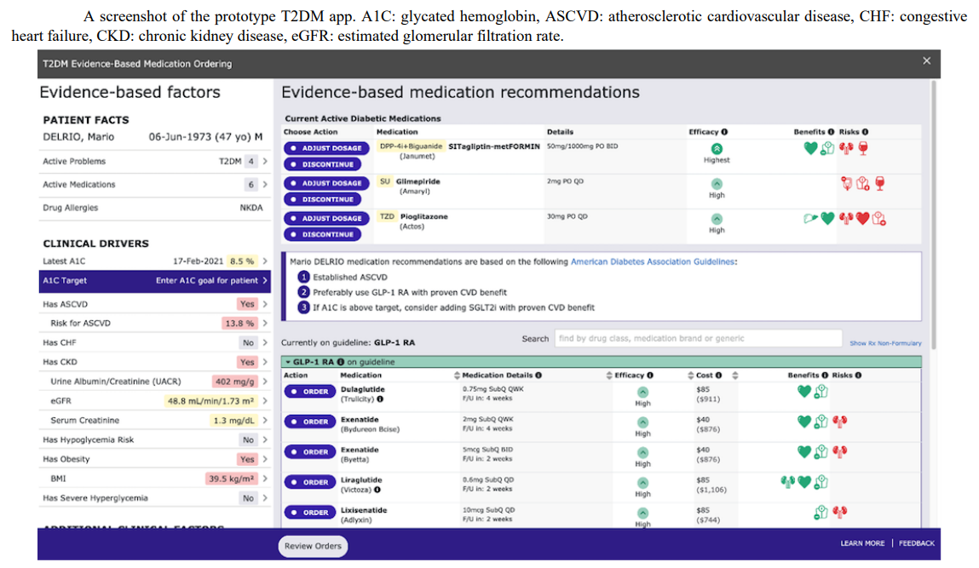

Slide 34
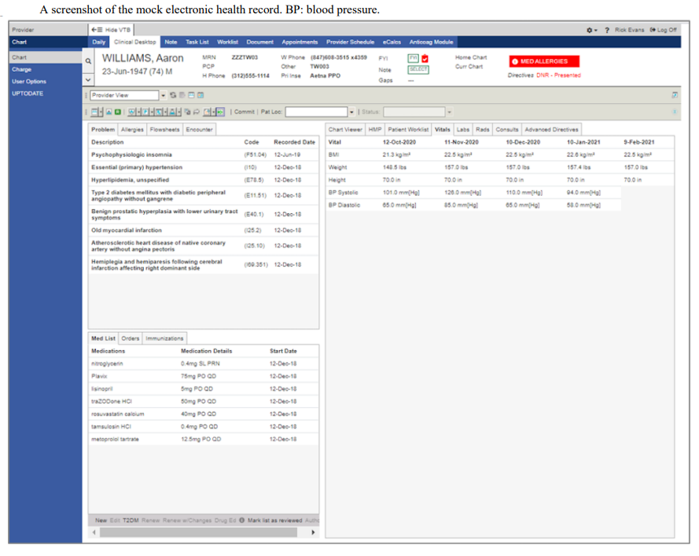

Slide 35
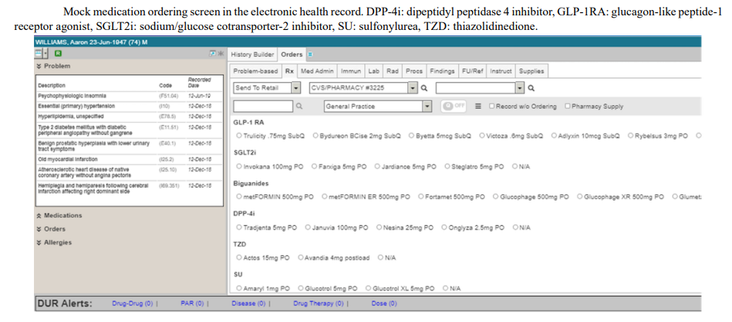

Slide 36
Examples of Clinical Decision Support Systems Application:
  Diagnosis Support
  Treatment Planning and Drug Management
  Patient Monitoring and Management
  Clinical Documentation
  Clinical Guideline Implementation

Slide 37
Role of EBM in clinical decision making
Decrease in unnecessary diagnostic tests and treatments
Saving time
Decrease in cost
Selecting the best treatment options (combinations)
Decrease in morbidity and mortality
Selecting the best diagnostic approach (pathway)
Prepare higher confidence in physicians (about their decisions for the patients) and patients (about treatments)
Decrease in mistakes
Higher efficiency

Slide 39
Electronic health record (EHR) systems and an integrated data analytics infrastructure are effective tools to enable policymakers to make better decisions, and for epidemiologists to conduct improved analyses.
Improved quality of clinical coding for better case finding, improved quality of health information in data sources, data-sharing agreements, and increased EHR coverage in the population can empower EHR-based COVID-19 surveillance systems.
Sheikhtaheri A, Kabir A, et al. A near real-time electronic health record-based COVID-19 surveillance system: An experience from a developing country. Health Inf Manag. 2022 Jul 15:18333583221104213.

Slide 40
Bias
Cognitive bias describes a variety of unconscious influences, short cuts and behaviours which influence our decision making. These “cognitive shortcuts” are useful tools for “fast and frugal” decision making as they “employ a minimum of time, knowledge, and computation to make adaptive choices in real environments”.
Cognitive factors are estimated to contribute to up to 75% of errors in internal medicine and errors in cognition have been identified in all steps of the diagnostic process including information gathering, association triggering, context formulation, processing and verification.
Examples of common cognitive biases that were found to effect clinical decision making include: • Outcome bias • Information bias • Risk Aversion • Ambiguity tolerance • Overconfidence • Availability bias • Reflective reasoning • Framing effect • Anchoring • Premature closure • Feedback bias • Blind obedience
Garrubba M, et al. Best practice to identify and prevent cognitive bias in clinical decision-making: Scoping review. Monash Health 2019: 1-7

Slide 41
Publication bias

Slide 43
A practical exam from EBM approach
Diagnostic accuracy studies address how well a test identifies the target condition of interest.
• Sensitivity, specificity, predictive values and likelihood ratios (LRs), odds ratio and accuracy are all different ways of expressing test performance.

Slide 44
Pretest and Posttest Probability
The pretest probability of a given condition varies by physician experience, season, geography, and the history and physical findings.
The pretest probability is the clinician’s best estimate of the probability of a specific disease before diagnostic testing and generally has a large impact on the diagnostic process.

Slide 45
In any clinical scenario, the diagnostic test serves to modify the pretest probability, which subsequently results in a new posttest probability.
The direction and magnitude of this change are determined by the test’s properties (eg, sensitivity, specificity, positive/negative predictive values, and likelihood ratios).

Slide 46
It is known that scoring systems can provide a quick, simple, (lower invasive) and inexpensive tool for checking a clinical diagnosis. If there is a broad discrepancy between the score and the initial clinical diagnosis, the possibility of error in that diagnosis should be considered.
Scoring systems also suggest the existence of a carrier state rather than a streptococcal illness in patients with a low score and positive cultures, and suggest the possibility of laboratory error in those with high scores and negative cultures.

Slide 47
Scoring systems can also be of considerable value to nonphysician medical personnel, especially where physicians are in short supply, in indicating the possibility of a streptococcal infection.
Breese reported that the 9-factor scoring system was sufficiently accurate and simple to use in clinical situations where a tentative quantitative estimate of the probability of a streptococcal infection would be useful before the culture reports.

Slide 48
Use of a simple nomogram initially proposed by Fagan allows easy conversion from pretest to posttest probability using the LR.

Slide 49
Ultimately, the value of a test will depend upon its ability to alter a pre-test probability of a target condition into a posttest probability that will influence a clinical management decision.
This can be achieved through the application of LRs.
A positive LR >10 and a negative LR <0.1 are considered to exert highly significant changes in probability, such as to alter clinical management.
Application of Fagan’s nomogram is a way of making these changes in probability by graphical means.

Slide 50
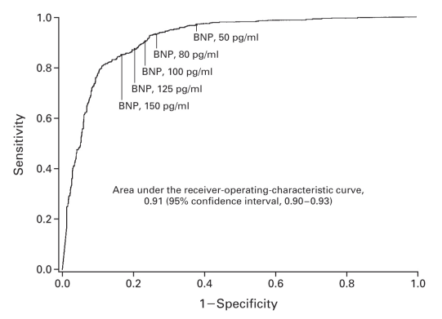
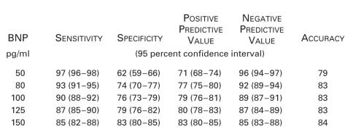

Slide 51
At lower BNP cut-offs, e.g. 50 pg/mL (17 µmol/L), there is higher sensitivity or better ability to identify patients with CHF, although this is compromised by lower specificity (i.e. the test falsely identifies more subjects without CHF).
The corollary of higher sensitivity, however is higher negative predictive value, in other words the test performs better as a “rule-out” test and enables the clinician to consider causes of dyspnea other than CHF.
Conversely, higher cut-offs are more likely to identify patients with CHF than due to other causes, in other words higher specificity and positive predictive value, giving a better “rule-in” test.

Slide 52
The ROC curve graphically displays the trade-off between sensitivity and specificity and is useful in assigning the best cut-offs for clinical use.
Overall accuracy is sometimes expressed as area under the ROC curve (AUC) and provides a useful parameter for comparing test performance between, for example, different commercial BNP assays and also the
related N-terminal pro-BNP assay.

Slide 53
Example of how The diagnostic parameters of a test are not intrinsic properties of the test and are critically dependent upon the clinical context within which they are employed
BNP was raised in the 40 patients (from 126) with LV systolic dysfunction compared with those with normal ventricular systolic function.
At a BNP concentration >17.9 pg/mL (abnormal), there was a sensitivity of 88% and specificity of 34% for identification of LV dysfunction.
The prevalence (or prior probability) of LV dysfunction in this study was 32% (40/126), lower than the 47% of patients with CHF in the ED setting.
The negative LR for a patient without a history of myocardial infarction, with normal chest radiography and electrocardiogram (ECG) is 0.53, yielding a posterior probability of LV dysfunction of 20%.

Slide 54
Post-test odds = pre-test odds X LR
Odds = prevalence / (1- prevalence)
Prevalence = odds / (1 + odds)

Slide 55
In this example, the prior probability of LV dysfunction in this clinical setting was 32%. By applying the equation above, this can be converted to odds.
Odds = 0.32 / (1 – 0.32)
Odds = 0.32 / 0.68 = 0.47 (or odds of approximately 1 to 2)
Post-test odds = 0.47 X 0.53 (LR of a negative test)
Post-test odds = 0.25
Post-test probability = 0.25 / (1 + 0.25)
Post-test probability = 0.2 or 20%

Slide 56
The posterior (or post-test) probability of LV dysfunction is therefore 20% in the presence of normal ECG and chest radiogram and the absence of a prior myocardial infarction.
When a negative BNP (<17.9 pg/mL) is added to the above combination of tests, the negative LR becomes 0.42 (as opposed to 0.53 without BNP).
It is an instructive exercise for the reader to follow the above train of calculations starting with the given pre-test probability of 32%. With the addition of BNP, the reader should be able to derive the post-test probability of 16%.

Slide 57
The point of this exercise is to show that adding a test for BNP to the determination of a patient’s history of myocardial infarction in the diagnostic screening process reduces the posterior probability to 16%, a small incremental advantage to that achieved by a combination of clinical history and traditional investigations likely to be undertaken in any case.
This leaves a residual 1 in 7 chance of LV systolic dysfunction which is unacceptably high and unlikely to deter a General Practitioner from referring the patient for echocardiography.
Therefore, in the clinical context of General Practice, the prevalence of CHF is lower than that among newly presenting dyspnoeic patients to the ED and the diagnostic performance of BNP is correspondingly lower.

Slide 58
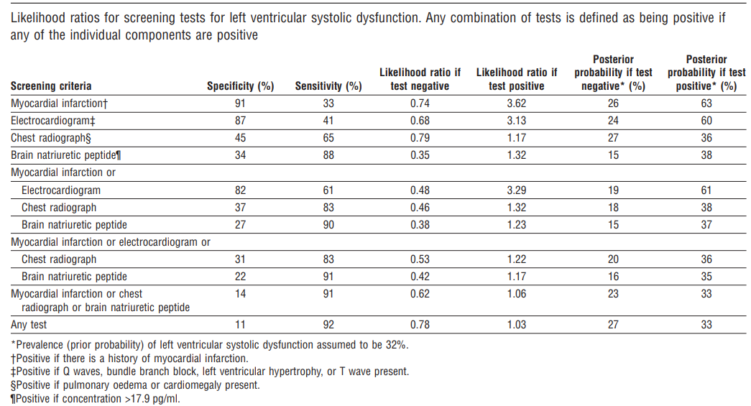

Slide 59
Another way of applying LRs without doing long-hand calculations is to use Fagan’s nomogram.

Slide 60
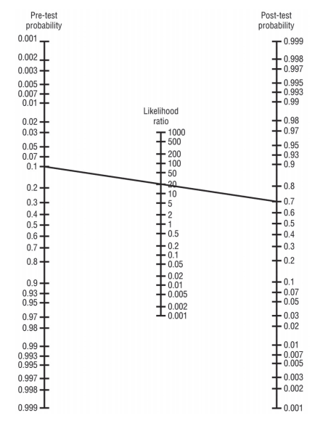
An example of Fagan’s nomogram. Prior probability is indicated on the vertical axis on the left of the nomogram and a line can be drawn through the BNP value in the middle (note the logarithmic scale) and extrapolated to the point where it intercepts the vertical axis on the right of the nomogram which corresponds to post-test probability.

Slide 61
Conclusion
Sensitivity, specificity, and predictive values are important properties of diagnostic tests, although each has its limitations.
LRs are useful for converting from pretest to posttest probability.
Articles describing diagnostic tests should report sensitivity, specificity, predictive values, and LRs or provide the reader with the data to calculate them.

Slide 62
If you are wondering which of the parameters described is more useful to evaluate a diagnostic test—sensitivity, specificity, LRs, or ROC curve—the answer is: it depends!
Each parameter describes a specific characteristic of the test, and depending on how you will use the test, one or another may be more useful. Now that you understand these concepts, interpreting a test result will be much more than just looking at the result.

Slide 63
Sen, Spc: Population based
PPV, NPV: individual based
PLR, NLR: test based

Slide 64
Parallel or serial tests
When tests were are in parallel combination, sensitivity increases, while specificity drops.
When used in serial combination, there is a decrease in sensitivity but increase in specificity.

